Slide 1
CMSC424: Database Design Module: Introduction/Overview
Instructor: Amol Deshpande
amol@umd.edu

Slide 2
CMSC424: Database Design Module: Introduction/Overview
Welcome and Logistics
Instructor: Amol Deshpande
amol@umd.edu

Slide 3
Welcome to CMSC424: Database Design
Course description
Students are introduced to database systems and motivates the database approach as a mechanism for modeling the real world. An in-depth coverage of the relational model, logical database design, query languages, and other database concepts including query optimization, concurrency control; transaction management, and log based crash recovery. Distributed and Web database architectures are also discussed.
I understand this semester will be challenging for everyone, and we will try to do what we can to make things easier
Typical in-person instruction, 2 classes a week etc.
Will record lectures but quality may not be as good
Will make available pre-recorded videos from Fall 2020
Expect about 75% overlap
Use the discussion forums, office hours as much as possible – assignments are to be done individually, but you are allowed to discuss among yourselves
Fill out the survey covering your background, your expectations, and potential issues (https://forms.gle/4CT4zXrTwu8B1DC9A -- will post on Piazza)
No Laptops without permission !

Slide 4
Welcome to CMSC424: Database Design
COVID Specific Notes
You should let me know of any excused absences due to COVID
We have built in enough flexibility to handle any excused absences without extra accommodations
Any additional accommodations MAY NOT be made
If you are not registered for the class (or aren’t on a waitlist), you cannot be here
Will record videos but may not be as good
Fall 2020 videos might be a better option
No Laptops without permission !

Slide 5
Logistics
Instructor: Amol Deshpande
5154 IRB, amol@umd.edu
Class Webpage: ELMS
Email to me: write CMSC424 in the title
Only if Piazza not suitable for some reason
Piazza allows private posts
TAs: Hasara Maithree, Keonwoo Oh, Srikavin Ramkumar

Slide 6
Logistics
Textbook:
Database System Concepts
Seventh Edition (6th Edition will be fine too)
Abraham Silberschatz, Henry F. Korth, S. Sudarshan
GitHub:
To distribute programming assignments
https://github.com/umddb/cmsc424-fall2022
Piazza: First resort for any questions
ELMS: General announcements will be posted there
GradeScope
We will use this for assignments, grading exams, etc.

Slide 7
Grading
12 (or so) weekly homeworks (25%) -- 1-3% each
Two Midterms (30%), Final (25%) – minimum of 40% on all combined to pass
Will weigh the higher-scoring midterm at 18%, and the lower-scoring midterm at 12%
5 Programming Assignments (20%)
Late Policy
Automatic one-week extension without penalty, but with an explanation of why
Beyond that: submissions allowed through the end of the semester with penalties

Slide 8
To-Dos
Sign up for Piazza, and GradeScope !
Set up the computing environment (Assignment 0), and make sure you can run Docker, PostgreSQL, Jupyter, etc.
Make sure you are aware of the key deadlines

Slide 9
CMSC424: Database Design Module: Introduction/Overview
Motivation
Instructor: Amol Deshpande
amol@umd.edu

Slide 10
Motivation
Book Chapters (6th Edition)
1.1, 1.2
Key Topics
Data-driven world and Big Data
Why managing large volumes of data is difficult
Drawbacks of using File Systems to store data
What we will cover in this course

Slide 11
Why Study Databases?
There is a *HUGE* amount of data in this world
Everywhere you see…
Personal
Emails, data on your computer
Enterprise
The original primary motivation
Banks, supermarkets, universities, airlines, phone call data etc.
Scientific
Biological, astronomical
World wide web
Social networks etc…

Slide 12
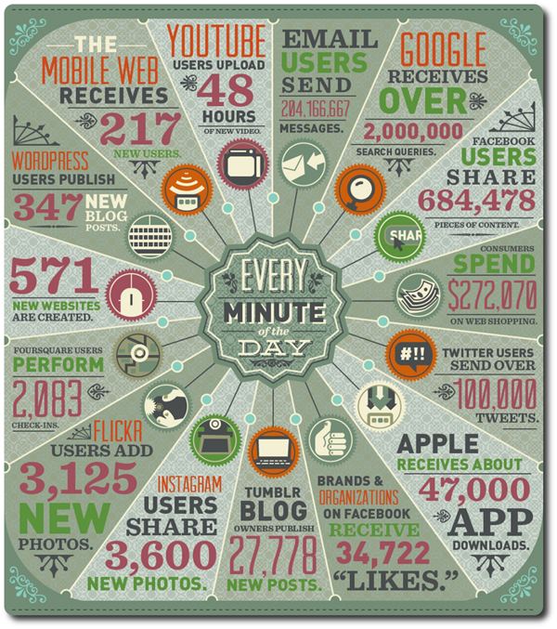
http://www.thebigdatainsightgroup.com/site/article/big-data-infographic

Slide 13
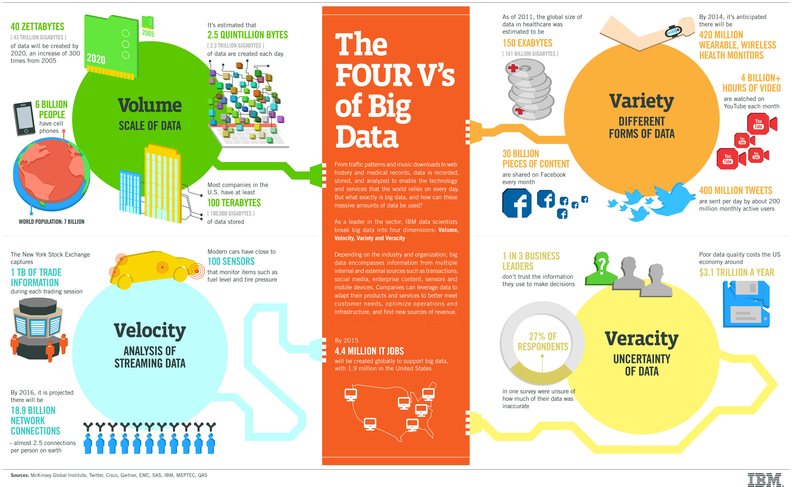

Slide 14
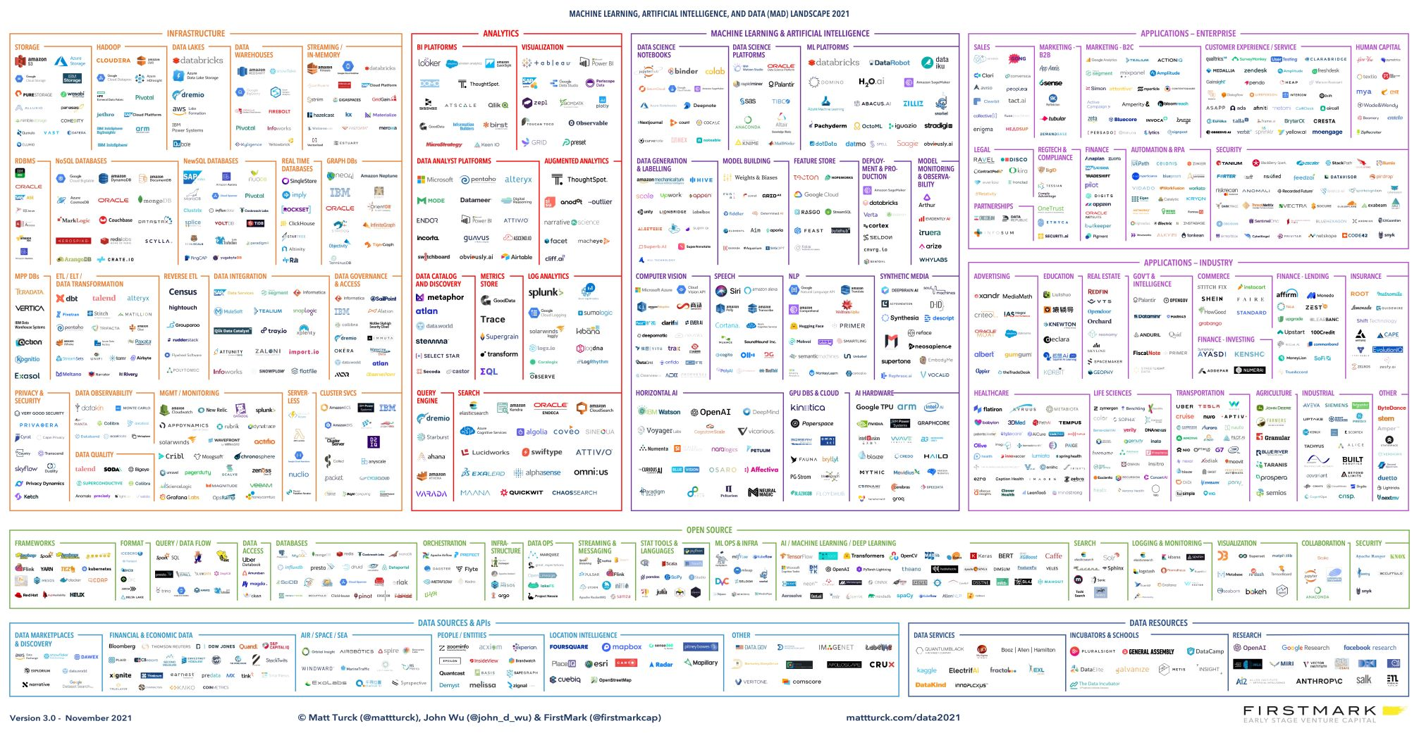
Data Management Systems
Data management systems at the center of most of the new innovative technologies
An incredible amount of ongoing work in building new types of systems

Slide 15
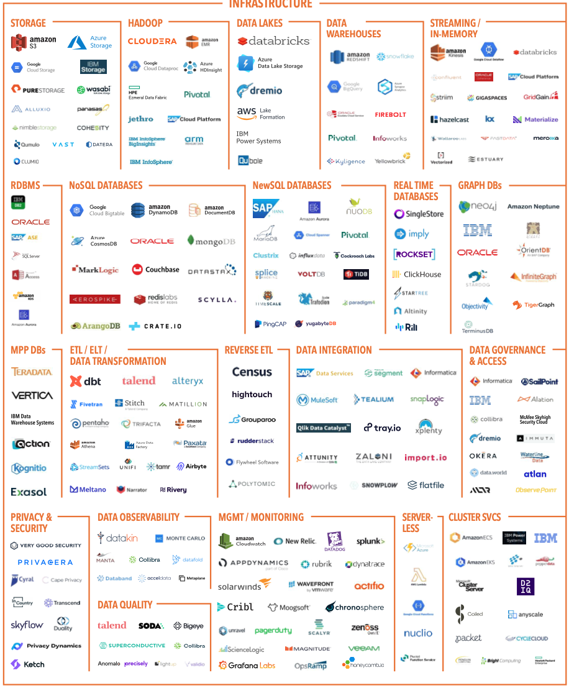

Slide 16
Data Management
A large fraction of the data still in traditional DBMS systems
Still open and active research areas about improving performance, energy efficiency, new functionalities, changing hardware spectrum (SSDs) and so on…
Much of the data not stored in traditional database systems today
For a variety of fairly valid reasons
- Stream processing systems (focusing on streaming data)
- Special-purpose data warehousing systems (most start from some RDBMS)
- Batch analysis frameworks (like Hadoop, Pregel, Spark, …)
Typically data stored in distributed file systems
- Key-value stores (like HBase, Cassandra, Redis, …)
Basically persistent distributed hash tables
- Semi-structured/Document data stores (for XML/JSON query processing)
- Graph databases
- Data lakes (e.g., scientific data, machine learning data)
However, many lessons to be learned from database research
We see much reinvention of the wheel and similar mistakes being made as early on

Slide 17
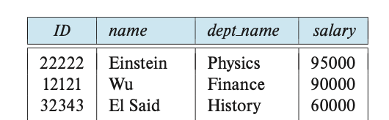
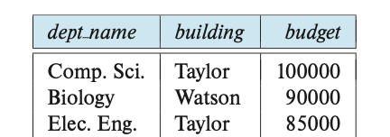
Data Management Challenges (1)
How to “represent”/”model” the data so users can easily understand, query, analyze, and update?
This is about the “logical” representation rather than “physical” -- we will worry about physical representation later
Whatever format we use needs to be easy for humans to work with, over a long period of time as data and usage evolves
As tables (like Excel)?
JSON Documents?
Graph?
Instructor: ID = 22222
{“instructors”: [
{“ID”: “22222”,
“name”: “Einstein”,
“dept_name”: “Physics”,
….
},
….
Department: Physics

Slide 18
Data Management Challenges (1)
How to “represent”/”model” the data so users can easily understand, query, analyze, and update?
This is about the “logical” representation rather than “physical” -- we will worry about physical representation later
Whatever format we use needs to be easy for humans to work with, over a long period of time as data and usage evolves
Many questions…
Pros and cons of different ways to do this
How to discuss whether our chosen data format is good or bad
e.g., some ways of storing data may increase conflicts in the data
How to deal with changes to the requirements and types of data being stored
Backwards compatibility is a huge problem leading to messy representations later on
Data Modeling

Slide 19
Data Management Challenges (2)
How to query the data? How to process/analyze it ? (from users’/analysts’ perspective)
“find the stores with the maximum increase in sales in last month”
We can’t expect the users to write Java programs
“how much time from here to Pittsburgh if I start at 2pm ?”
Data is there (GPS, live traffic data), but requires predictive capabilities
Increasing need to convert “information” to “knowledge”: Data mining/Machine Learning
Predicting which TikToks/tweets to show, …
Needs to be easy to use, but powerful enough for what needs to be done
Otherwise users will simply take out all the data and write their own programs
Query Languages and Programming Abstractions

Slide 20
Data Management Challenges (3)
How to query the data? How to process/analyze it ? (from implementation perspective)
How to handle the increasing scale of the data
How to support more and more complex analytics/machine learning over the data
How to process the data in real-time, as it is arriving into the system
How to find the best way to execute a query with least resources/time
How to utilize large numbers of machines to execute queries more efficiently
…
Database Query Engines
Big Data Systems

Slide 21
Data Management Challenges (4)
Modifying/updating the data given:
Many users simultaneously updating the data…
While the data is (potentially) replicated across the globe…
And any server or the network may go down at any point.
If allowed to run concurrently
a = a + 10
inc = a * 0.15
a = a + inc
b = b - 10
save a & b
b = b - inc
save a & b
Update 1
a = a + 10
b = b - 10
save a & b
Update 2
inc = a * 0.15
a = a + inc
b = b - inc
save a & b
Doesn’t happen if forced to run one after the other, but unacceptable performance

Slide 22
Data Management Challenges (4)
Modifying/updating the data given:
Many users simultaneously updating the data…
While the data is (potentially) replicated across the globe…
And any server or the network may go down at any point.
Update
a = a + 10
b = b - 10
save a
save b
Need to figure out how to handle
partially finished transactions
More complications if we do update-in-place
(i.e., a = a + 10 updates the original value)
System crashes

Slide 23
Data Management Challenges (4)
Modifying/updating the data given:
Many users simultaneously updating the data…
While the data is (potentially) replicated across the globe…
And any server or the network may go down at any point.
user 2
update b
update a
user 1
update a
update b
Geographically distributed replicas
data item a
date item b
data item a
date item b
data item a
date item b
Machine 1
Machine 2
Machine 3

Slide 24
Data Management Challenges (4)
Modifying/updating the data given:
Many users simultaneously updating the data…
While the data is (potentially) replicated across the globe…
And any server or the network may go down at any point.
From Users’ perspective:
What kinds of guarantees can be provided to the users about the end result, and about the order in which updates are made?
What if the users are okay with weaker guarantees?
From Implementation perspective:
How to provide the guarantees efficiently?
Transactions

Slide 25
Data Management Challenges (5-∞)
Data Integration, Transformation, and Cleaning
Large amounts of time spent in just getting data ready for analysis, by some accounts 90-95%
Real-world data has a lot of noise, missing values, etc…
Security
Access control, use of encryption, …
Privacy
How to allow users to query data without revealing it
How to enable public data releases (e.g., by Census Buereau)
…

Slide 26
What we will cover…
Data Modeling
Data represented in tabular forms (Relational)
JSON/Document Data Model (MongoDB)
Entity-relationship Model for Schema Design
Normalization theory to formally define a ”good” schema
We will discuss a more primitive data model as well (Apache Spark)
Query Languages and Programming Abstractions
SQL, MongoDB Query Language, Apache Spark MapReduce-like Framework, Some others
Query Engines and Big Data Frameworks
Considerations in efficient implementations
Transactions
How to reason about consistency and durability guarantees (ACID)
Basics of how to achieve those guarantees in centralized and distributed settings

Slide 27
What we will cover…
This course is NOT about learning how to write SQL queries
Although we will practice that a fair bit…
It is about learning the foundations of how data management systems are built and why they are built that way, so you:
Can think about the design decisions more systematically (e.g., through use of normalization theory and E-R modeling)
Understand the role of data modeling and how different models impact design decisions
Develop a deeper understanding of the differences and similarities between different types of database systems (e.g., PostgreSQL vs MongoDB)
Are equipped (to some extent) to design next-generation data systems
Are able to reason about performance of the queries/tasks

Slide 28
Structure of the Course
Introduction
Motivation, data abstraction, common data systems architectures today
Relational Model + SQL (Three Programming assignments)
How to model and query data using SQL
How to update data using transactions and considerations therein
Schema Design: Entity-relationship Models and Normalization
How to create a database schema, and how to ensure it is “good”
NoSQL (somewhat of a misnomer) (Two Programming assignments)
Document, key-value, and graph data models
MongoDB and its Query Language
Map-reduce Model and Apache Spark
Implementation Issues
Different types of storage, and how to ensure reliability in presence of failures
Indexes for faster retrieval of data
How an SQL query is processed and optimized
How to do concurrent updates correctly
How to ensure consistency in presence of failures

Slide 29
Main Changes from Fall 2020 + 2021
Web App Development and Programming Project
An important topic, but insufficient time to cover it in sufficient depth
Much less discussion of disks and disk-based indexes
Playing an increasingly less important role in modern database systems
More SQL coverage
More in-depth NoSQL
MongoDB (including a programming project)
Deeper discussion of other NoSQL data models
(MapReduce/Spark has been covered in the past)
Split up the “transactions” discussion
Changes to programming projects

Slide 30
Summary
Why study databases ?
Shift from computation to information
Always true in corporate domains
Increasing true for personal and scientific domains
Need has exploded in recent years
Data is growing at a very fast rate
Solving the data management problems continues to be the key
Database Management Systems provide
Data models and querying abstraction
Guarantees about data integrity
In presence of concurrent access, failures…
Speed !!

Slide 31
CMSC424: Database Design Module: Introduction/Overview
Data Models and Data Abstraction
Instructor: Amol Deshpande
amol@cs.umd.edu

Slide 32
Motivation
Book Chapters (6th Edition)
1.3
Key Topics
Data Models and Why Capturing “Structure” is Important
Data Abstraction, and Views
Logical and Physical Data Independence

Slide 33
Database Management Systems
Provide a systematic way to solve data management issues
Aim is to allow easy management of high volumes of data
Storing , Updating, Querying, Analyzing ….
What is a Database ?
A large, integrated collection of (mostly structured) data
Typically models and captures information about a real-world enterprise
Entities (e.g. courses, students)
Relationships (e.g. John is taking CMSC 424)
Usually also contains:
Knowledge of constraints on the data (e.g. course capacities)
Business logic (e.g. pre-requisite rules)
Encoded as part of the data model (preferable) or through external programs

Slide 34
Database Management Systems
Massively successful for highly structured data
Why ? Structure in the data (if any) can be exploited for ease of use and efficiency
If there is no structure in the data, hard to do much
Contrast managing emails vs managing photos
Much of the data we need to deal with is highly structured
Some data is semi-structured
E.g.: Resumes, Webpages, Blogs etc.
Some has complicated structure
E.g.: Social networks
Some has no structure
E.g.: Text data, Video/Image data etc.

Slide 35
Structured vs Unstructured Data
A lot of the data we encounter is structured
Some have very simple structures
E.g. Data that can be represented in tabular forms
Significantly easier to deal with
We will focus on such data for much of the class
Account
bname | acct_no | balance
Downtown Mianus Perry R.H | A-101 A-215 A-102 A-305 | 500 700 400 350
Customer
cname | cstreet | ccity
Jones Smith Hayes Curry Lindsay | Main North Main North Park | Harrison Rye Harrison Rye Pittsfield

Slide 36
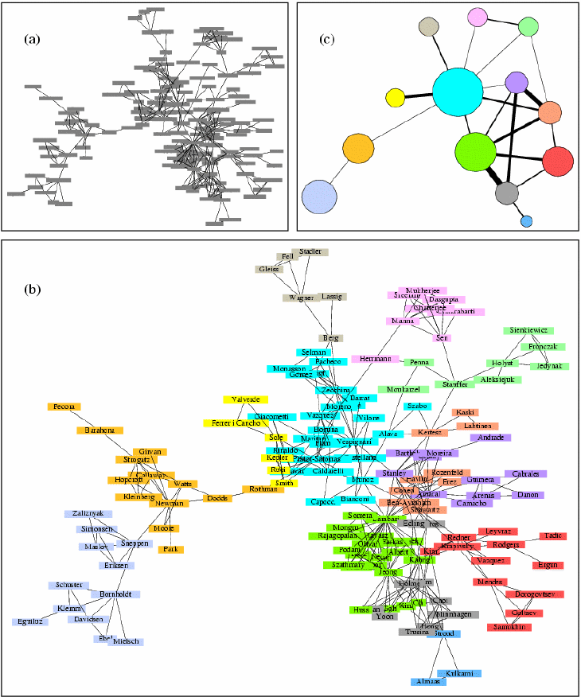
Structured vs Unstructured Data
Some data has a little more complicated structure
E.g graph structures
Map data, social networks data, the web link structure etc
Can convert to tabular forms for storage, but may not be optimal
Queries often reason about graph structure
Find my “Erdos number”
Suggest friends based on current friends
Growing importance in recent years in a variety of domains: Biological, social networks, web…

Slide 37
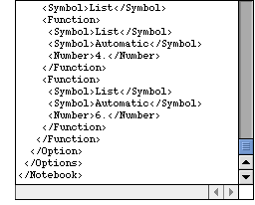
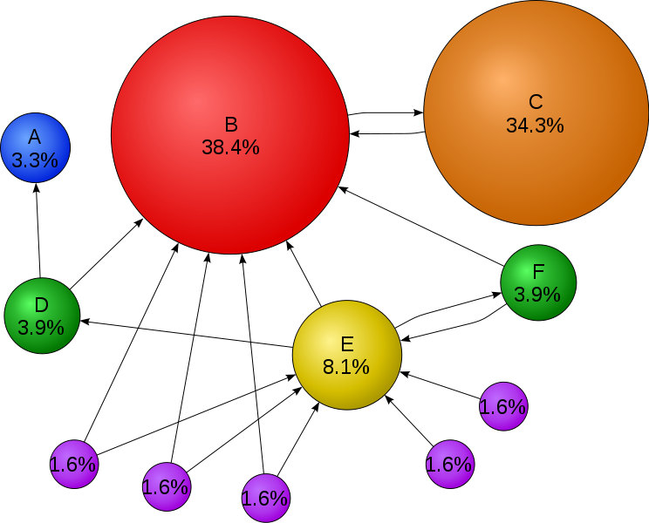
Structured vs Unstructured Data
Increasing amount of data in a semi-structured format
XML – Self-describing tags (HTML ?)
Complicates a lot of things
We will discuss this toward the end
A huge amount of data is unfortunately unstructured
Books, WWW
Amenable to pretty much only text search… so far
Information Retreival research deals with this topic
What about Google search ?
Google search is mainly successful because it uses the structure (in its original incarnation)
Video ? Music ?
Can represent in DBMS’s, but can’t really operate on them
circle size == page importance == pagerank
more incoming links → higher pagerank
incoming links from important pages → higher pagerank

Slide 38
Database Management Systems
Massively successful for highly structured data
Why ? Structure in the data (if any) can be exploited for ease of use and efficiency
How ?
Two Key Concepts:
Data Modeling: Allows reasoning about the data at a high level
e.g. “emails” have “sender”, “receiver”, “…”
Once we can describe the data, we can start “querying” it
Data Abstraction/Independence:
Layer the system so that the users/applications are insulated from the low-level details

Slide 39
Data Modeling
Data modeling
Data model: A collection of concepts that describes how data is represented and accessed
Schema: A description of a specific collection of data, using a given data model
Some examples of data models that we will see
Relational, Entity-relationship model, XML, JSON…
Object-oriented, object-relational, semantic data model, RDF…
Why so many models ?
Tension between descriptive power and ease of use/efficiency
More powerful models → more data can be represented
More powerful models → harder to use, to query, and less efficient

Slide 40
Data Abstraction
Probably the most important purpose of a DBMS
Goal: Hiding low-level details from the users of the system
Alternatively: the principle that
applications and users should be insulated from how data is structured and stored
Also called data independence
Through use of logical abstractions

Slide 41
Data Abstraction
View Level
What data users and application programs see ?
…
View 1
View 2
View n
Logical
Level
What data is stored ?
describe data properties such as
data semantics, data relationships
How data is actually stored ?
e.g. are we using disks ? Which
file system ?
Physical
Level

Slide 42
Data Abstraction
View Level
…
View 1
View 2
View n
Logical Data Independence
Protection from logical changes
to the schema
Logical
Level
Physical Data Independence
Protection from changes to the
physical structure of the data
Physical
Level

Slide 43
Data Abstractions: Example
A View Schema
course_info(#registered,…)
View Level
…
View 1
View 2
View n
Logical Schema
students(sid, name, major, …)
courses(cid, name, …)
enrolled(sid, cid, …)
Logical
Level
Physical Schema
all students in one file ordered by sid
courses split into multiple files by colleges
Physical
Level

Slide 44
CMSC424: Database Design Module: Introduction/Overview
DBMS Architectures; Industry Outlook
Instructor: Amol Deshpande
amol@umd.edu

Slide 45
Motivation
Book Chapters (6th Edition)
1.4, 1.9 (to some extent)
Key Topics
Data Definition and Data Manipulation Languages
Typical Database Architecture
Current Industry Outlook

Slide 46
Database System
A DBMS is a software system designed to store, manage, facilitate access to databases
Typically uses a specific data model, and
Supports some level of physical and logical data independence
Provides:
Data Definition Language (DDL)
For defining and modifying the schemas
Data Manipulation Language (DML)
For retrieving, modifying, analyzing the data itself
Guarantees about correctness in presence of failures and concurrency, data semantics etc.
Common use patterns
Handling transactions (e.g. ATM Transactions, flight reservations)
Archival (storing historical data)
Analytics (e.g. identifying trends, Data Mining)

Slide 47
Example: Relational DBMS and SQL
SQL (sequel): Structured Query Language
Data definition (DDL)
create table instructor ( ID char(5), name varchar(20), dept_name varchar(20), salary numeric(8,2))
Data manipulation (DML)
Example: Find the name of the instructor with ID 22222 select name from instructor where instructor.ID = ‘22222’

Slide 48
Database Architecture: Pre-2000’s
All data was typically in hard disks or arrays of hard disks
RAM (Memory) was never enough
So always had to worry about what was in memory vs not
Almost no real “distributed” execution
Different from “parallel”, i.e., on co-located clusters of computers
Relatively well-understood use cases
Report generation
Interactive data analysis and exploration
Supporting transactions
From Chapter 20

Slide 49
Traditional RDBMS Architecture
Clients may be anywhere – e.g., ATMs, desktops, laptops, web apps etc.
Talk to the database using standard protocols like JDBC/ODBC, SOAP, or REST (today), or proprietary protocols
Some sort of load balancer or intake mechanism
Typical components in a database system: some for queries, some for transactions
Maybe on a single physical computer or a cluster connected by a fast network
Data Storage Systems:
Punch cards (long time ago)
Hard disks (still prevalent)
SSDs
Need “redundancy” and “fault-tolerance”
Data once stored should always be there
RAID = Redundant Array of Independent Disks

Slide 50
Database Architecture : Today
Much more diversity in the architectures that we see
More modern hardware architectures
Massively parallel computers
SSDs
Massive amounts of RAM – often don’t need to worry about data fitting in memory
Much faster networks, even over a wide area
Virtualization and Containerization
Cloud Computing
As a result: Data and execution typically distributed all over the place
Much more diversity in data processing applications
Much more non-relational data (images, text, video)
Data Analytics/Machine learning more common use-cases
Much more diversity in “data models”
Document data models (JSON, XML), Key-value data model, Graph data model, RDF

Slide 51
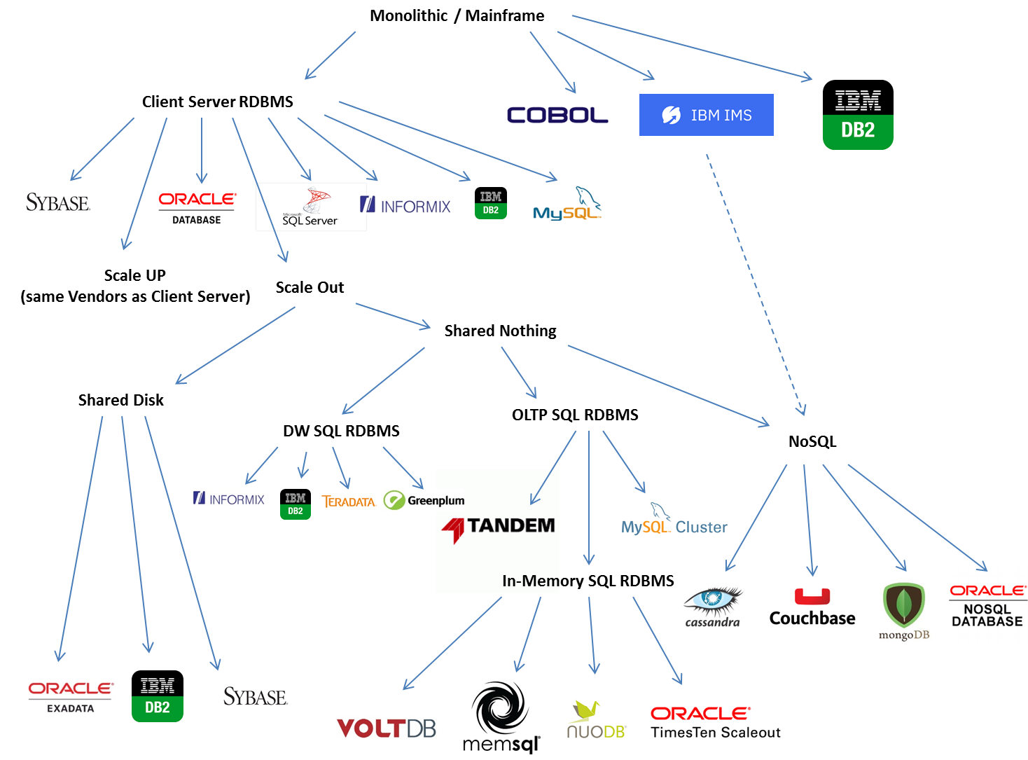
From: https://blogs.oracle.com/timesten/the-evolution-of-db-architectures
(Oracle-focused)

Slide 52
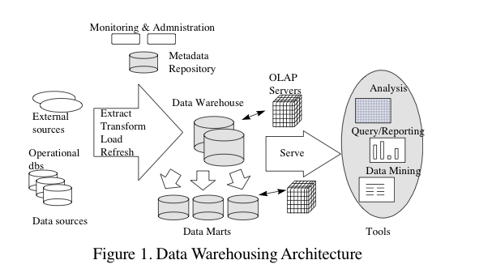
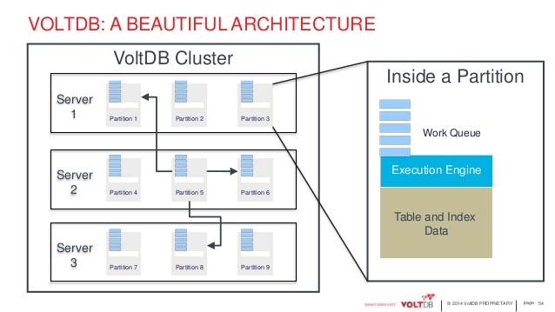
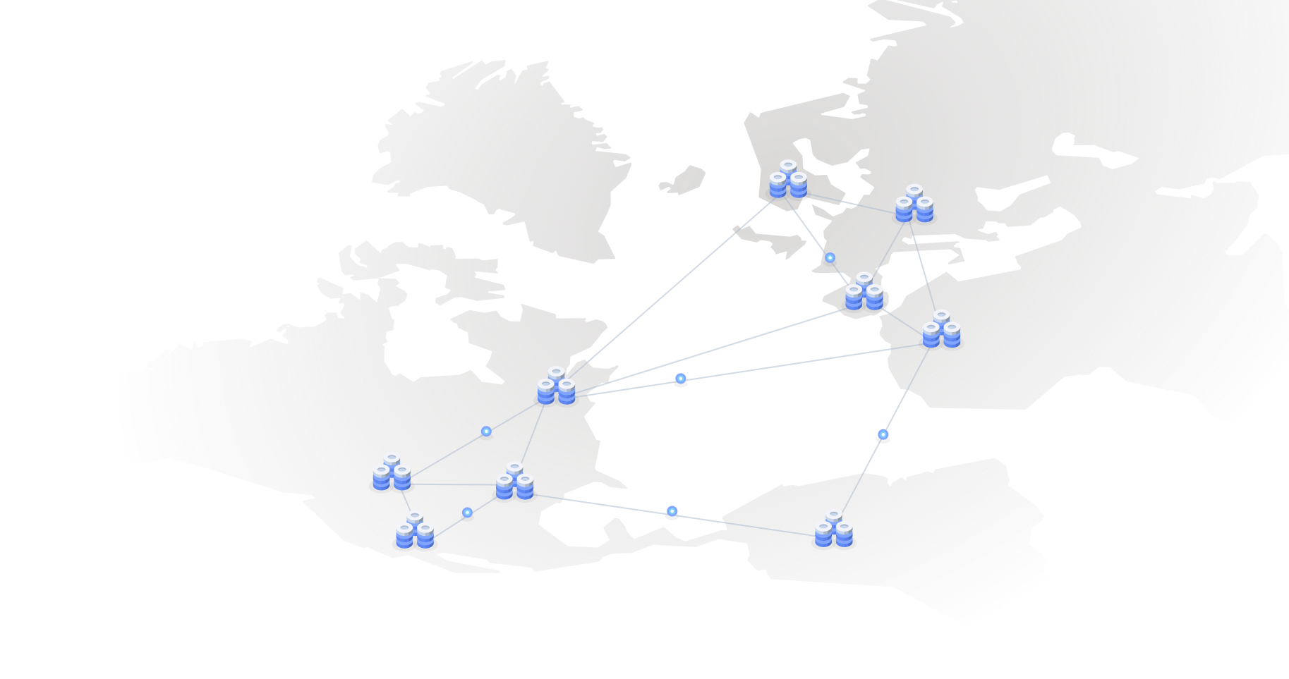
Data Warehouses
For: Large-scale data processing (TBs to PBs)
Parallel architectures (lots of co-located computers)
SQL and Reporting
No transactions
In-memory OLTP (on-line transaction processing)
For: Extremely fast transactions
Many-core or parallel architectures
Very limited SQL – mostly focused on “writes”
Typically assume data fits in memory across servers
Highly available, distributed OLTP
For: Distributed scenarios where clients are all over the world
Focus on “consistency” – how to make sure all users see the same data
Limited SQL – mostly focused on “writes”
Considerations of memory vs disk less important

Slide 53
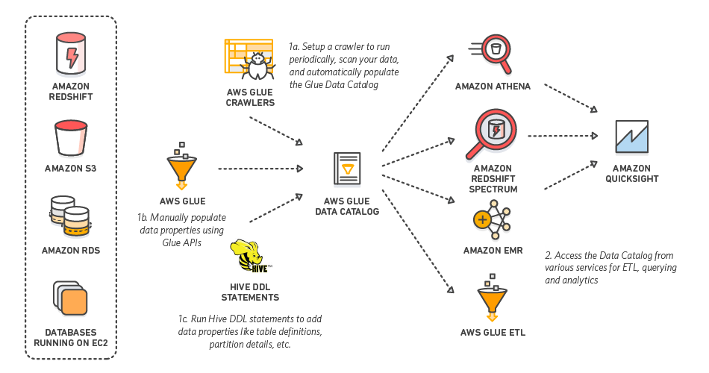
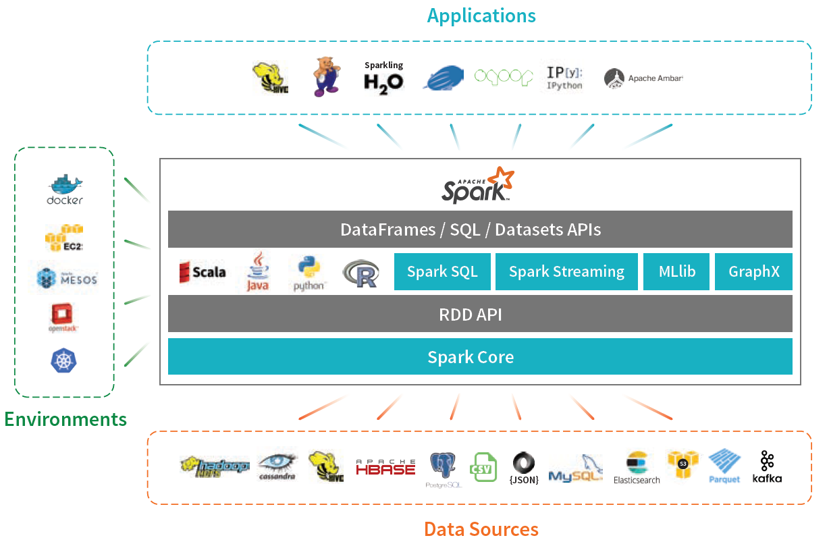
Extract-Transform-Load Systems, or Map-Reduce, or Big Data Frameworks
For: Large-scale, “ad hoc” data analysis
Mix of parallel and distributed architectures
Data usually coming from many different sources
Mix of SQL, Machine Learning, and ad hoc tasks (e.g., do image analysis, followed by SQL)
AWS Glue
Apache Spark

Slide 54
Okay…
Key takeaway: Modern data architectures are all over the place
We haven’t talked about NoSQL (MongoDB, etc.), Machine Learning, “Streaming”…
Fundamentals haven’t changed that much though
We are still either:
Going from some “input datasets” to an “output dataset” (queries/analytics)
Modifying data (transactions)
SQL is still very common, albeit often disguised
Spark RDD operations map nicely to SQL joins and aggregates (unified now)
MongoDB lookups, filters, and aggregates map to joins, selects, and aggregates in SQL
But “performance trade-offs” are all over the place now
30 years ago, we worried a lot about hard disks and things fitting in memory
Today, focus more on networks
Focus has shifted to other aspects of data processing pipelines
Analytics/Machine learning, data cleaning, statistics

Slide 55
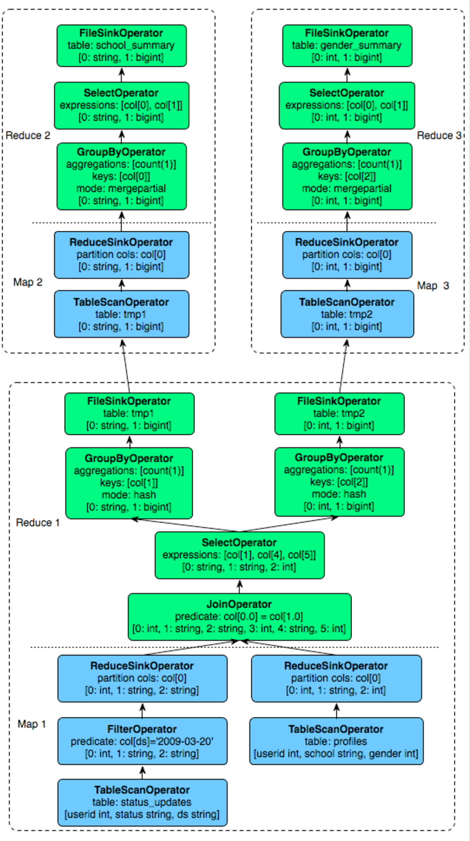
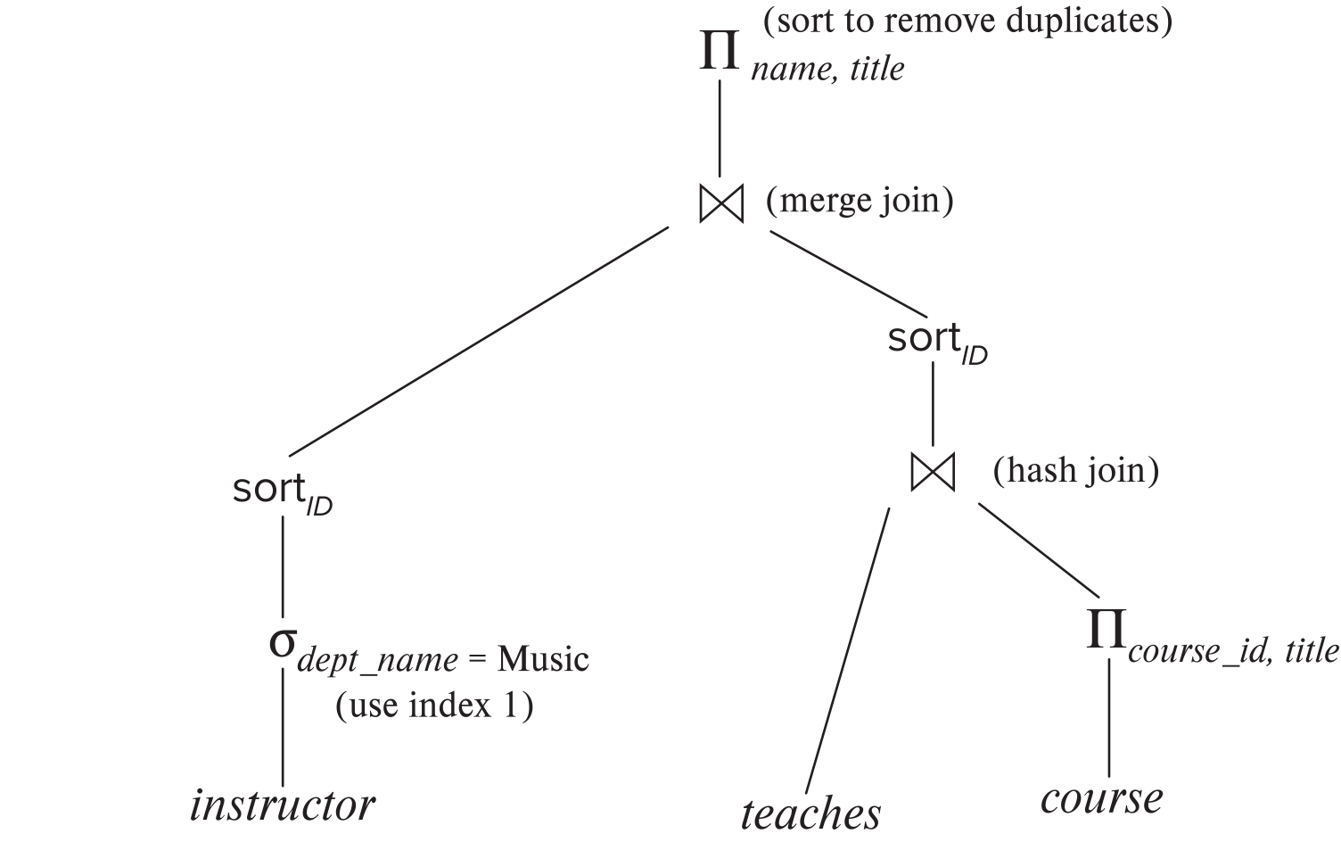
Query Plans vs…
SQL ”Query Plan”
Apache Hive ”Query Plan”
(Hive is an SQL layer on top of Hadoop)

Slide 56
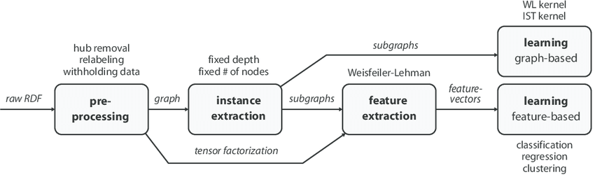
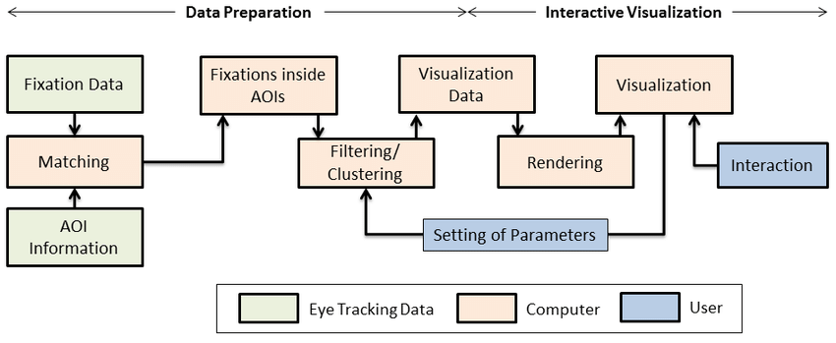
vs … Data Transformation Pipelines
Machine Learning Pipeline
Data Preparation and Visualization Pipeline

Slide 57
Okay…
Many similarities across different ways to process and analyze data
At its simplest:
Maybe Tables in an RDBMS, Files in HDFS, or Images in a key-value store
Maybe Joins, or Aggregates, or Machine Learning Tasks, or Data Cleaning Tasks, or…
Dataset 1
Binary Operation 1
Dataset 2
Dataset 3
Binary Operation 2
Ternary Operation 1
Dataset 4
Dataset 5
Unary Operation 1
Unary Operation 1
Output Dataset 1
Maybe Another RDBMS Table, a New File, or a Machine Learning Model

Slide 58
Okay…
Many similarities across different ways to process and analyze data
Some considerations that we see repeated:
Are there multiple ways to accomplish the goals?
i.e., are there multiple pipelines or SQL Query Plans that will accomplish the same task
How to “enumerate” all of them?
i.e., how to automatically come up with all the different options?
How to decide which is the ”best”?
Ideally based on some consideration of total cost (e.g., total CPU time)
How to ”find” the best plan?
Called “query optimization” in databases
RDBMSs have been doing this for 4-5 decades now
The classic paper on SQL query optimization is from 1979
Outlined the approach still in use today
Same ideas re-discovered repeatedly in other contexts (e.g., Hadoop)

Slide 59
In This Class…
We have to limit the scope drastically
Focus on:
Single-server Relational Databases
Use a simplified computational environment
Go deep into different ways to execute queries, and find the best queries
Will briefly discuss:
Parallel architectures and query processing there
Map-reduce architectures and considerations there-in
Most of the key concepts valid in modern databases (including NoSQL) and Big Data Frameworks

